Slide 1
PROJECT PRESENTATION ON SMART OFFICE WITH IOT
Course Title: Wireless Network Lab
Course Code: CSE-428 Section: 191D2
Presented By
Umme Loara -191002187
Department of CSE,
Green University of Bangladesh.
Presented To
Dr. Nazib Abdun Nasir
Assistant Professor,
Department of CSE,
Green University of Bangladesh.

Slide 2
Table of the Contents
Introduction
Step to Goals
Design Goals
Overall Scenario
IP Configuration
SMTP
DNS Configuration
Email Sending Checking
FTP
Routing
Wireless Router Configuration
Iot Devices Connection with Wireless Router
Registration Server Account
Connecting IoT devices with IoT server
Controlling IoT devices
Practical Implications
References

Slide 3

Introduction
In this project, I try to summarize the connection of two smart office using Cisco Packet Tracer. In this project, I will create SMTP, FTP, Routing, and some IOT devices like lighting, door-access, room controlling, fire, wireless connections and will try to create roaming between two smart office.

Slide 4
Step to Goals
Constructing Environment or demo model
Finding out the information's
Constructing structures
Give IP, Subnet, Gateway etc.
Checking message passing, FTP checking, Simulation, IoT devices.

Slide 5
Design Goals
To enrich our knowledge in Cisco Packet Tracer.
To develop the idea of roaming of two Smart Office .
To gather knowledge of any type of networks connections .
To enrich our knowledge how a smart office is better than a normal office.

Slide 6

Overall Scenario

Slide 7
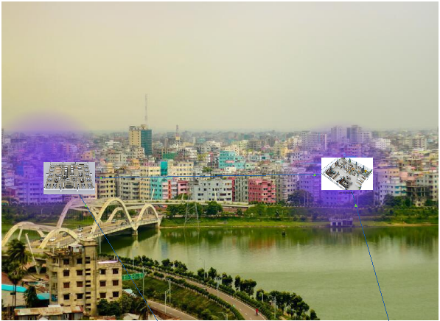
Continued…

Slide 8
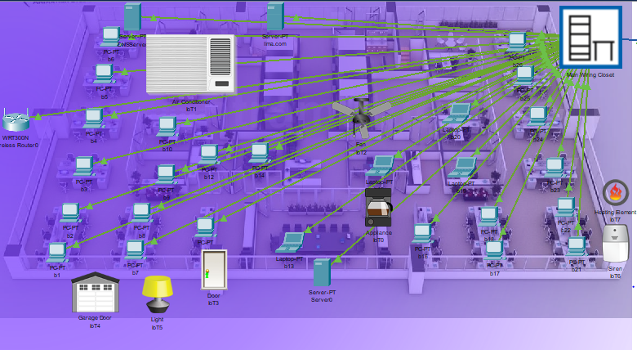
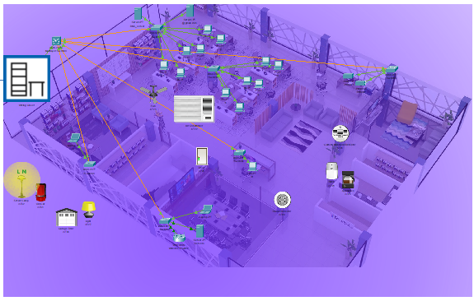
Continued…

Slide 9

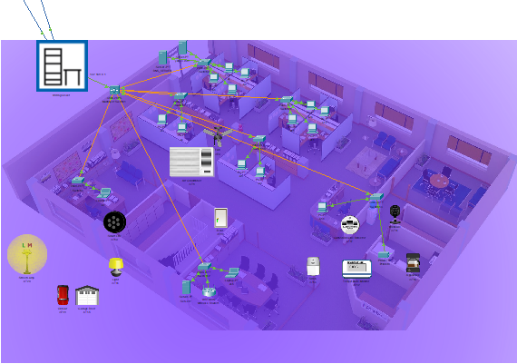
Continued..

Slide 10
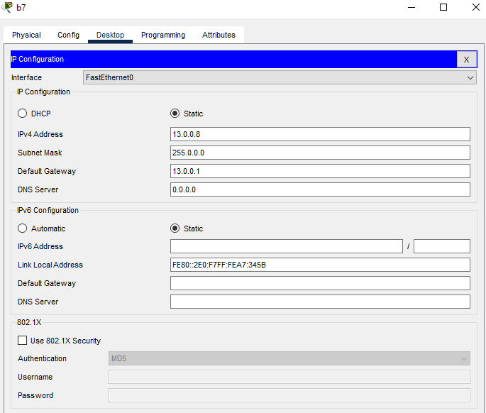
IP Configuration- User
Need to configure the IP address, Subnet Mask, Default Gateway for all PC’s, Laptop.

Slide 11
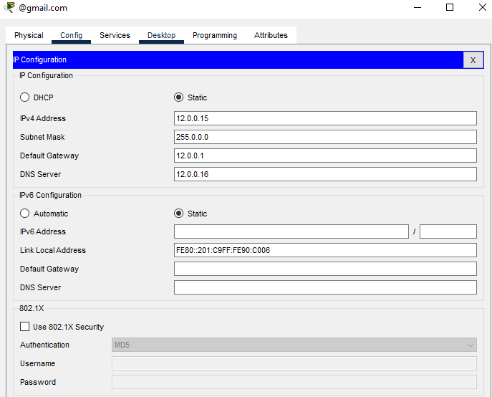
IP Configuration- Mail Server
For doing SMTP, FTP, Routing, need to configure IP address for mail server, DNS server.

Slide 12
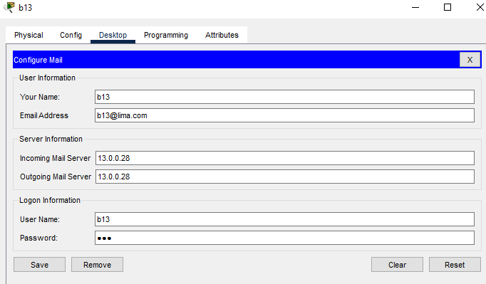
SMTP- Mail Configuration
For SMTP, it is need to configure all the PC’s, Laptop’s own email account.

Slide 13
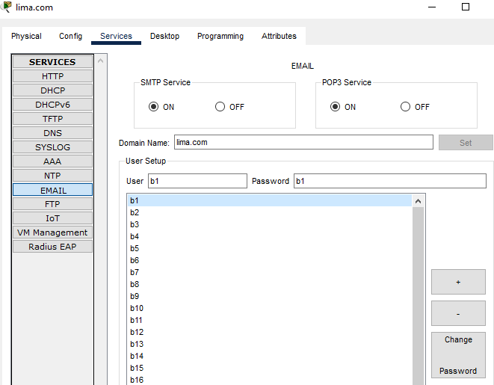
SMTP- Email Configuration
User’s domain name set in mail server and the users name and their password add in mail server for doing SMTP.

Slide 14
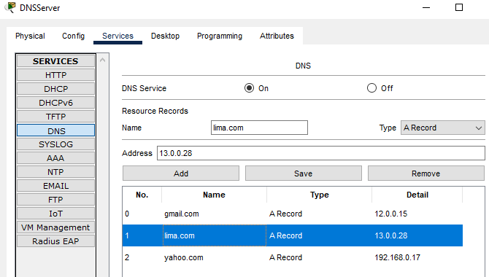
DNS Configuration
DNS server add all the mail servers domain name, address and type of domain name, that helps to pass email one PC’s to another.

Slide 15
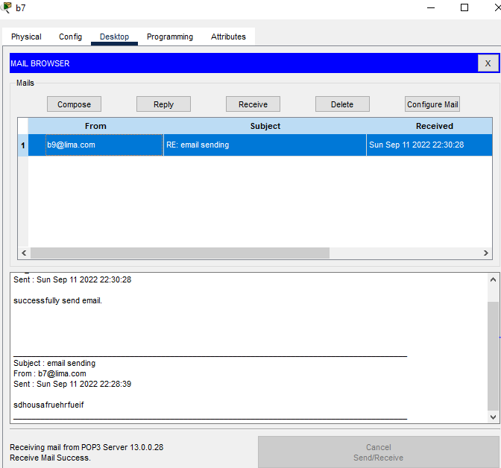
Email Sending Checking
For sending email, go to PC’s or Laptop’s desktop then go to email and compose email. And in my project it show success.

Slide 16
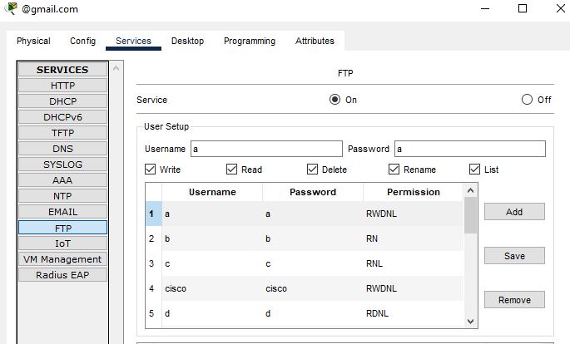
FTP- Configuration
For FTP, we can used mail server and by giving username & password and permission, FTP is done.

Slide 17
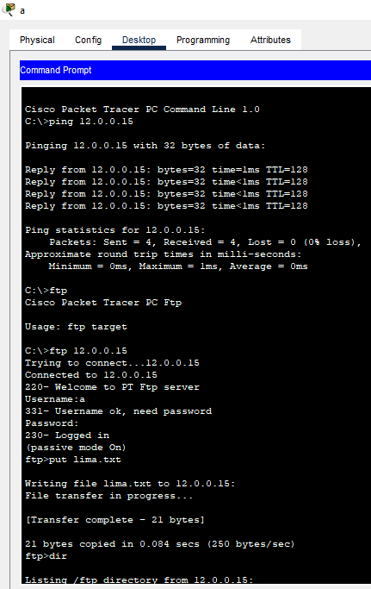
FTP- Checking
For FTP checking, it need to go to command prompt in any PC’s that r in same network and then ping with IP address of the server where FTP configuration is done then connect to the FTP server and logged in by username and password. And checking the read, write, delete, rename, list permission for the PC’s and Laptops.

Slide 18
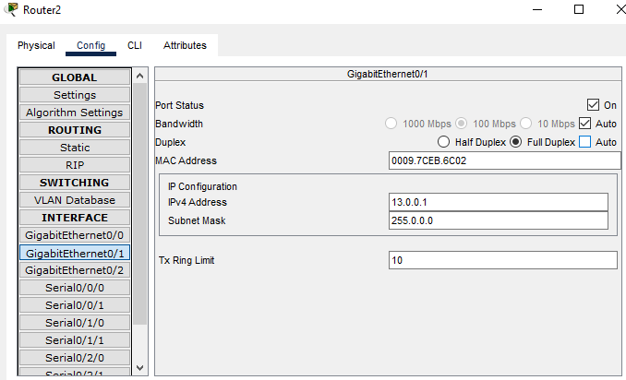
Routing- Gigabit Ethernet
For routing, firstly, add switch to router’s GigabitEthernet port. Then give the IP address of default gateway and click on port status.

Slide 19
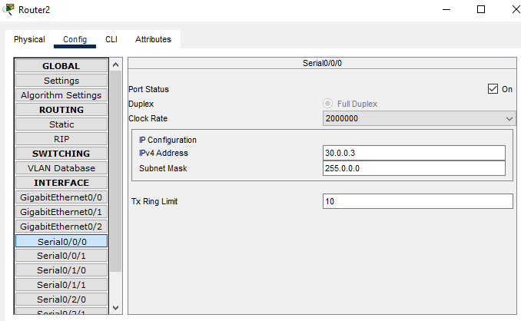
Routing- Serial Port for Routing
For routing, secondly if there are more than one router that time it need to configure serial port. That means for router to router connection, serial port needed, and also need to give IP address for each serial port and click on the port status.

Slide 20
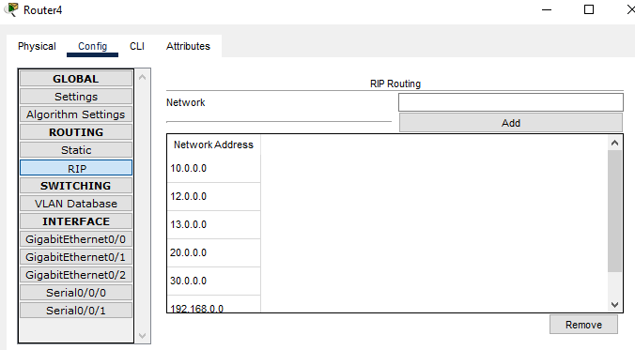
Routing- RIP Routing
It is very complicated to use static routing and easy to use dynamic routing. For that, give the network IP that are used and add them. It is need to configure the RIP routing in all router.

Slide 21
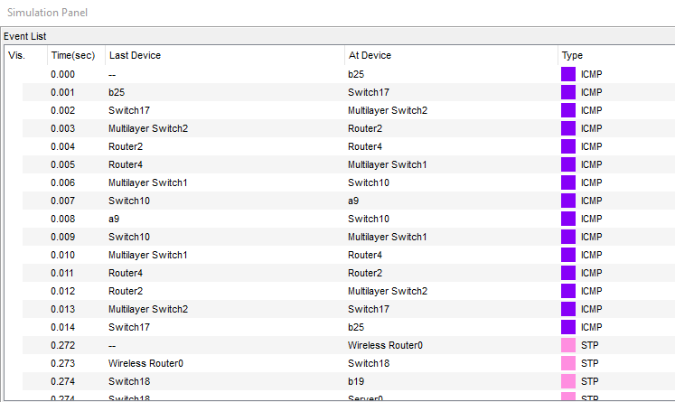
Routing- Simulation

Slide 22
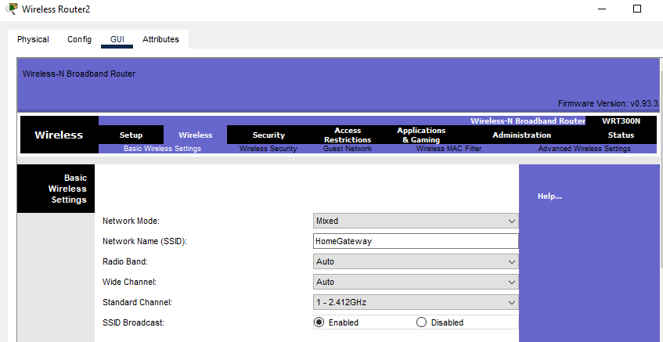
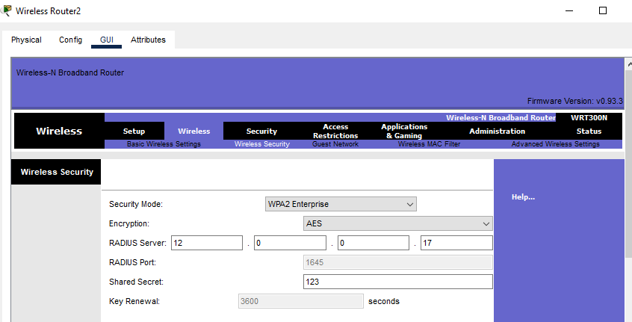
Wireless Router Configuration
For Wireless router configuration GUI, need to give the network name, radius server IP, security mode and shared secret.

Slide 23
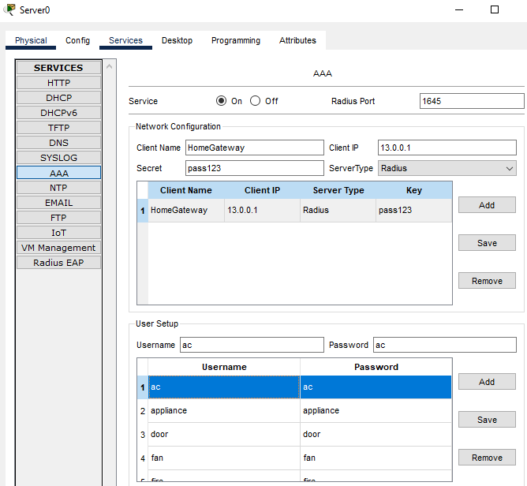
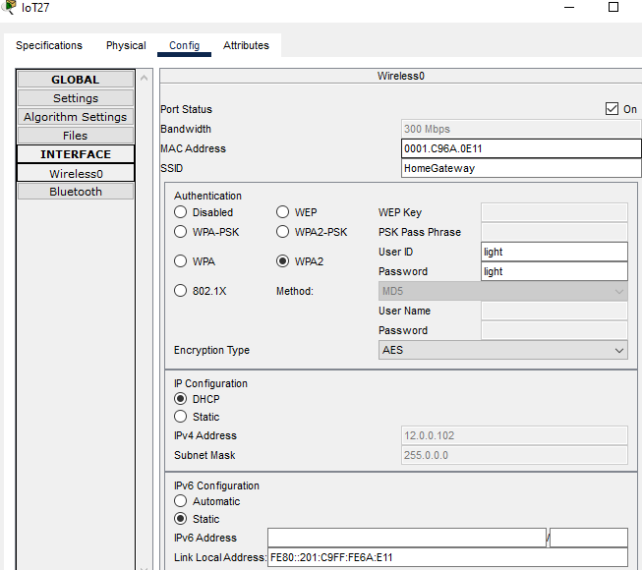
Iot Devices Connection with Wireless Router
IoT device is connected by SSID and user IP and password. Before that, user ID and password need to be set in a server.

Slide 24
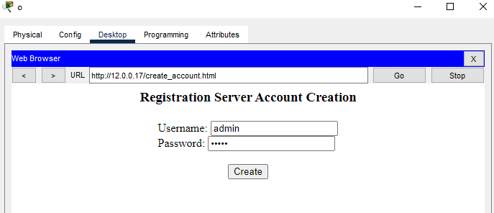
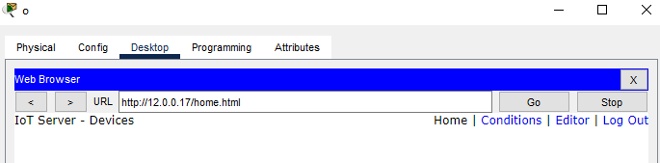
Registration Server Account
For controlling the IoT device, need to create registration server account. For that, I go to web browser and give the radius IP address and by giving user name and password I create a account.

Slide 25
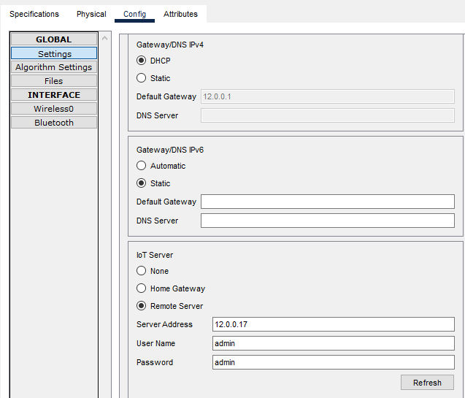
Connecting IoT devices with IoT server
Now, it is need to connect each and every IoT device with IoT server for remote controlling. For that by clicking on remote server and giving the server address, user name and password and by clicking on connect, the device is under control.

Slide 26
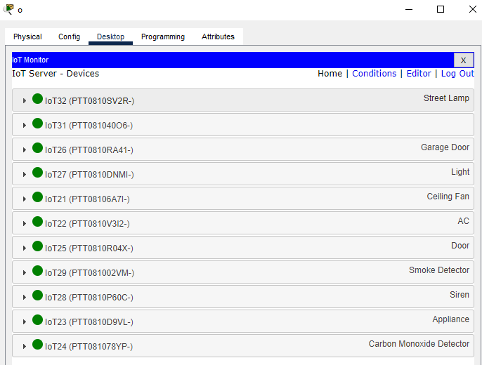
Controlling IoT devices
Now after connecting all IoT device, when one go to the controlling laptop device IoT monitor the scenario will be like this,
One can control the IoT devices by the controlling Laptop.

Slide 27
Practical Implications
Can help a beginner to learn the basic of Cisco Packet Tracer.
Able to do another types of networks like college, University, Two cities connections etc.
Also after completing the project in real, the communications would be better.

Slide 28
References
[1] Kurose, J. F., & Ross, K. W. (2009). “Computer Networking: A Top-Down Approach (Vol. 4)”. Boston, USA: Addison Wesley.7th Edition.
[2] https://www.youtube.com/watch?v=KwhrRyWPv64&t=591s
[3] https://www.youtube.com/watch?v=puwn2Kxj4HE
[4]https://www.academia.edu/39707451/IRJET-_SMART_OFFICE_MONITORING_SYSTEM_USING_IOT

Slide 29


